Slide 1
INSERT CITATION
Using MENDELEY Desktop

Slide 2
Install Plugin
To activate the Insert Citation feature, a plugin for MS Word is necessarily installed
Installation steps:
  Open Mendeley Desktop and then Login
  After logging in, access the Tools menu and select Install MS Word Plugin
  The plugin will automatically be installed on MS Word
Check on MS Word to make sure the plugin is installed
  Open MS Word
  Access the Reference menu
  Click the Insert Citation menu in Mendeley logo

Slide 3
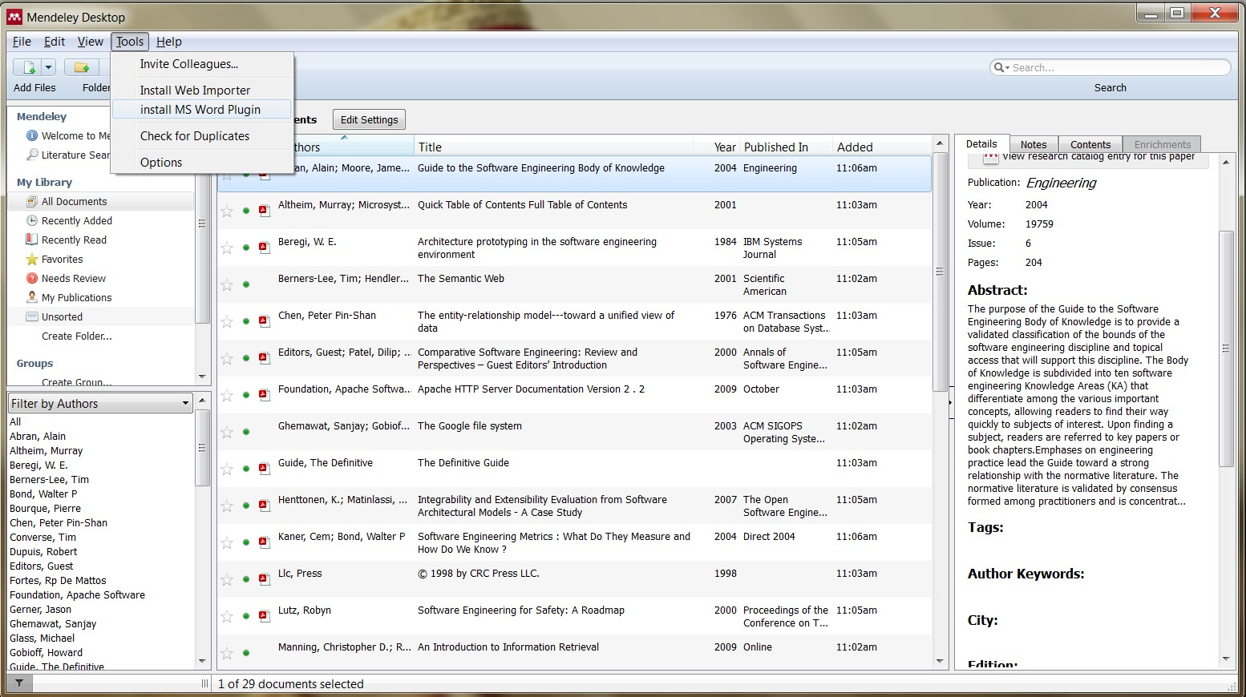

Slide 4
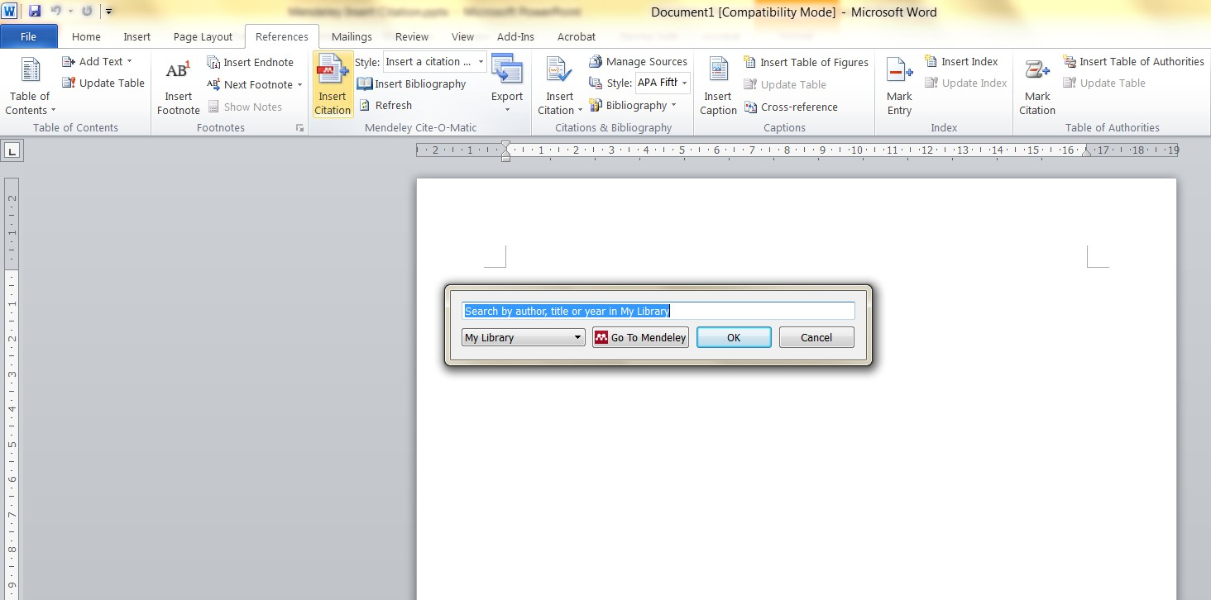

Slide 5
Insert Citation
Steps to insert citation
Open MS Word and click the References menu
Then click Insert Citation
A pop-up window will appear to specifically search the data based on the author name, title, or year
Once found, select the desired data and click OK to enter the citation
Data that can be searched are those that have been imported into "My Library"

Slide 6
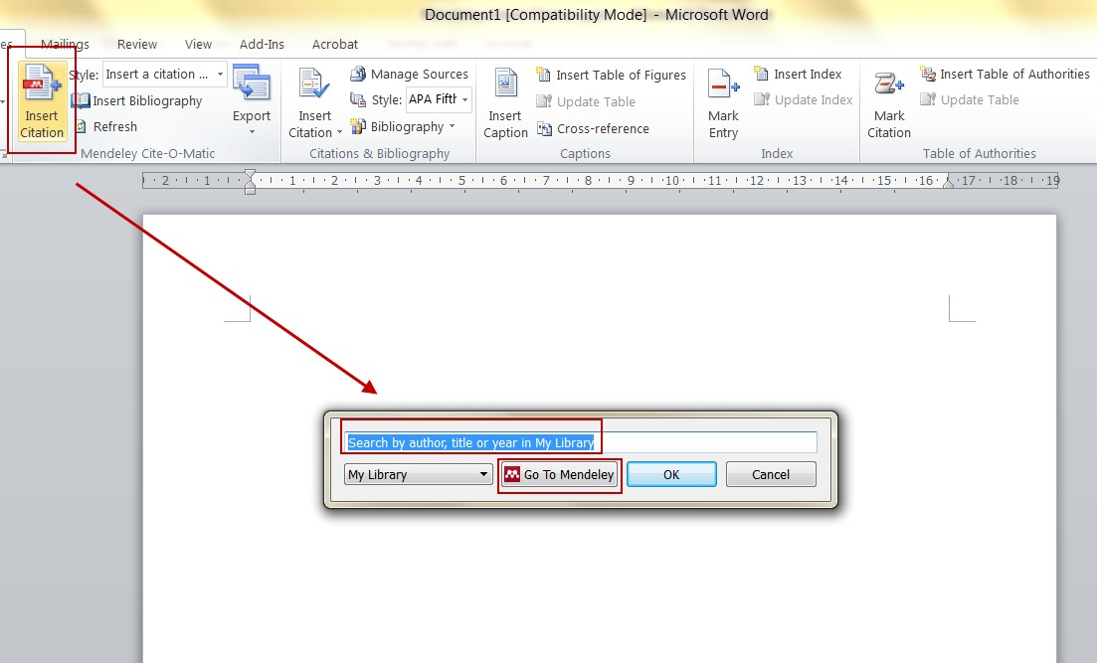

Slide 7
Insert Citation
If finding the text to cite is difficult, please select "Go To Mendeley" menu
"My Library" menu will appear on the Mendeley Desktop application
Select the article to cite and then click the "Cite" button

Slide 8
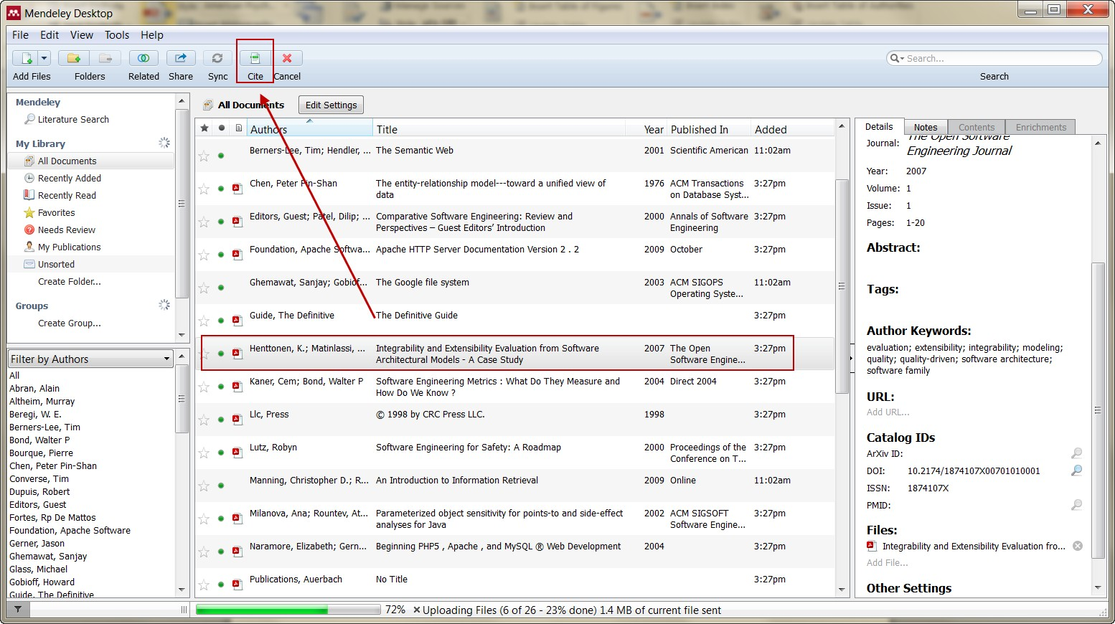

Slide 9
Insert Bibliography
After completing the citation, the Bibliography can be entered automatically.
Click the References menu then click the Insert Bibliography menu
The system will automatically arrange the Bibliography according to the style chosen.

Slide 10
